Slide 1
REST API
A BRIEF OVERVIEW

Slide 2

API – Application Programming interface

Slide 3
What is API?
API (Application Programming Interface software) is a set of instructions, standards or requirements that enables a software or app to employ features/services of another app, platform or device for better services.
An API is the base of all the apps that deal with data or enable communication between two products or services.

Slide 4
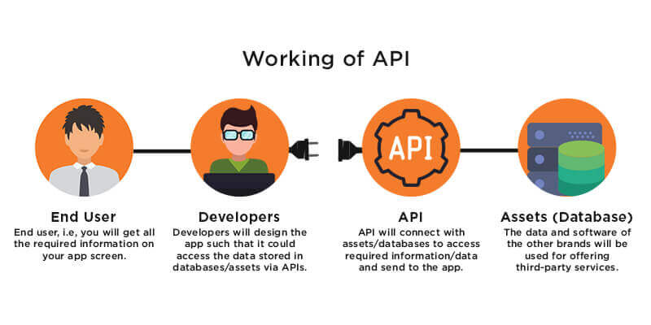
Working of API

Slide 5

REST – Representational state transfer

Slide 6
What is REST API?
Representational State Transfer (REST) is a software architecture that imposes conditions on how an API should work.
It is light-weighted and based on the idea of making a particular data available only when requested by sharing references to the data instead of the entire copy of the data itself.

Slide 7
Principles of REST
Uniform Interface
Statelessness
Layered System
Cacheability
Code on demand

Slide 8

HTTP- Hypertext Transfer Protocol

Slide 9
HTTP Methods
REST API operates different methods on the required resource using HTTP.
The major methods are:
GET: GET is a method used to access resource on a server and instruct the server to filter the data before sending.
POST: POST is a method to send the data to server. They include the data representation with the request.

Slide 10
PUT: PUT is a method that is used to update existing resources on the server.
PATCH: PATCH is a method that is used to partially update the existing resource.
DELETE: DELETE is a method that is used to delete an existing resource on the server.

Slide 11
API Security Models
It is important to keep the database secure and hence various security methods are employed by RESTful API. They are:
API Keys.
HTTP authentication.
OAuth.

Slide 12

How to integrate an API in a website?
To integrate an API into a website we use the Fetch API functionality of javascript.
AN EXAMPLE

Slide 13
Thank You
Made by Shrirang Elkunchwar

